Slide 1

APA 7th Edition Basics
General
The Four Parts
The basic requirements for every paper
Title page, Abstract, Body, and Reference page(s).
Style
A Closer Look
Language is important.
In-text citations and references.
Be sure to ask questions at any point by speaking up or by typing your question in the chat.

Slide 2
General
The basic requirements for every paper. APA requirements beyond the citations.

Slide 3
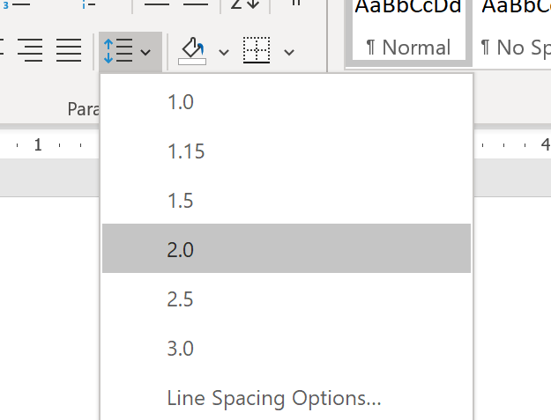
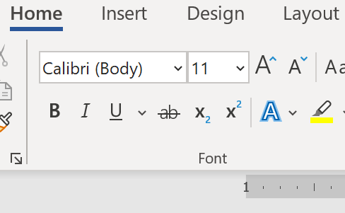
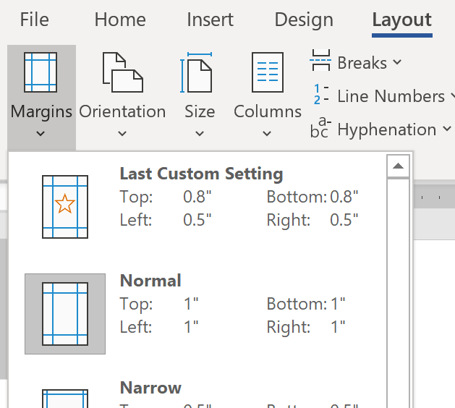
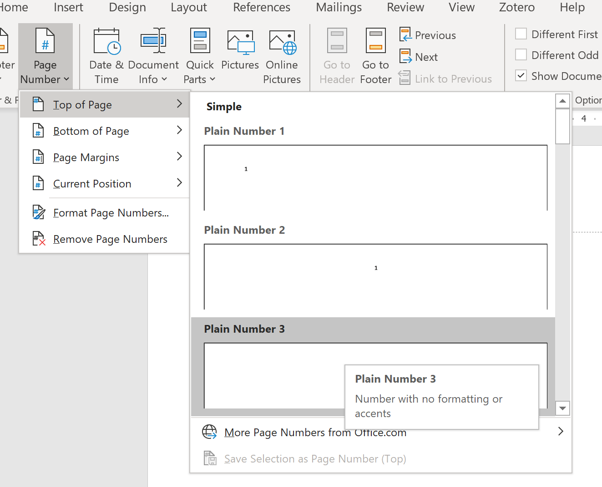
Basic formatting
Sans serif or serif font
Double spacing
Page number at right margin of header
1” margins

Slide 4
Style
Language is important. How you should present your material in your paper.

Slide 5
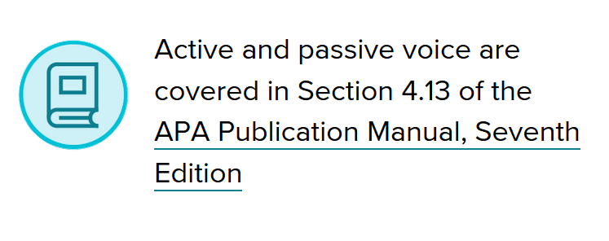
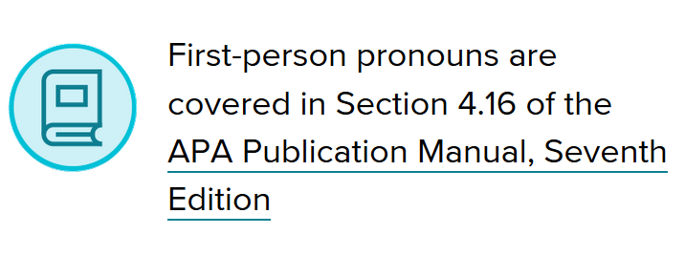
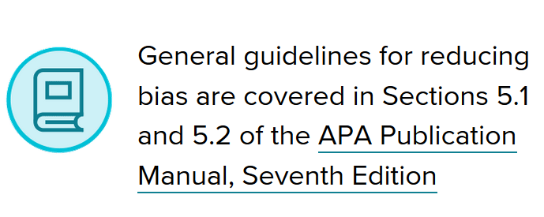
Wording basics
Avoid the following:
Slang and informal language
Contractions
Starting sentences with conjunctions
Unnecessary flowery wording (fluff)
Images from Style and Grammar Guidelines, by American Psychological Association, 2019, APA Style (https://apastyle.apa.org/style-grammar-guidelines). Copyright 2019 by American Psychological Association.

Slide 6
The Four Parts
Title page, Abstract, Body, and Reference page(s). What’s needed; what’s optional.
Alert!
APA 7th Edition has separate title page formats for a student paper and a professional paper. We will be discussing the student paper.

Slide 7
Student papers
Abstract (optional, unless specified by professor or institution)
References
Title Page
Body

Slide 8
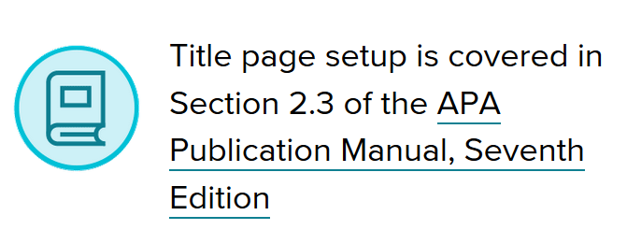
Title page
Page number is aligned at the right margin in the header
1
Title of Paper
Student Name
School Affiliation
Course Number and Name
Professor Name
Assignment Due Date
Include:
Full paper’s title in bold
Blank line
Your full name
The school’s name
Course number and name
Professor/Instructor’s name
Assignment due date
Image from Style and Grammar Guidelines, by American Psychological Association, 2019, APA Style (https://apastyle.apa.org/style-grammar-guidelines). Copyright 2019 by American Psychological Association.

Slide 9
Abstract
2
Abstract
The abstract is a summary of the paper and is
double-spaced. The first line of the abstract is
not indented, and the total length is typically
limited to 250 words. It may be written as a
single paragraph or in structured form with labels
such as Objective, Method, Results, and
Conclusions.
Keywords: Used for indexing in databases
The word Abstract is bold, centered on first line
Remember that the Abstract is a summary of the paper, not an introduction. It should report the conclusions of the paper rather than simply introduce its contents.
Tip!
The abstract is used by others to briefly understand the contents of your paper. Be clear, concise, and comprehensive.

Slide 10
Body
3
Title of Paper
Throughout the body of the paper, every
paragraph is indented five spaces. There are
in-text citations for direct quotes and paraphrases.
All uses of someone else’s ideas, opinions, theory,
fact, statistic, graph, or other information must
be cited as shown here (Jones, 2009). The general
form for in-text citations is the author’s last name
and year of publication.
Direct quotes of less than 40 words are en-
closed in “quotation marks,” and the page or
paragraph number is added to the citation.
Tip!
Some academic fields and many instructors do not allow the use of direct quotes. Paraphrases are required instead.
The paper’s title is bold, centered on first line
Begin the paper with an introduction. It may be one paragraph or many more, depending on the assignment. DO NOT label it Introduction unless otherwise directed.
APA writing style emphasizes accuracy and clarity. Here are some tips:
Use active voice.
Use third person. First person is allowed if referring directly to paper’s author, unless instructor directs otherwise.
Do not use slang, informal language, or contractions.
Cite source information clearly.

Slide 11
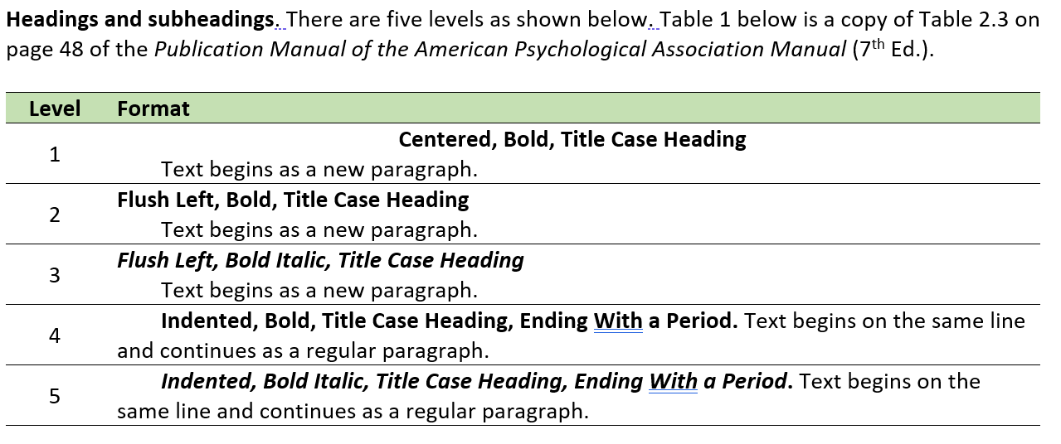

Body: Headings
Image from Style and Grammar Guidelines, by American Psychological Association, 2019, APA Style (https://apastyle.apa.org/style-grammar-guidelines). Copyright 2019 by American Psychological Association.

Slide 12
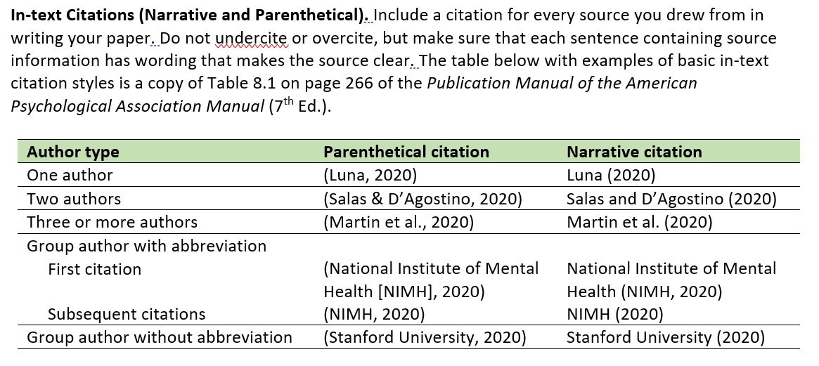
Body: Citations

Slide 13
References page
12
References
Griffin, R. W., & Ebert, R. J. (2002). Business
management (6th ed.). Prentice Hall.
Jencks, C. (2004). Nature talking with nature. The
Architectural Review, 215(1283), 66-75.
Kenneth, I. A. (2000). A Buddhist response to the nature
of human rights. Journal of Buddhist Ethics, 8, 12-26.
Talbot, A., & Tanenhause, F. B. (2009). Nutrition
monitoring strategies.
http://www.eatright.org/strategies/
The word References is bold, centered on first line
The references are listed alphabetically by the first author’s last name. The authors are listed in the order they appeared in the source.
All references answer four basic questions:
WHO – The name of the author (last names followed by initials)
WHEN – The publication date (usually just the year)
WHAT – The title of the source (Written as a regular sentence)
WHERE – The publishing organization (journal, book publisher, etc.)

Slide 14
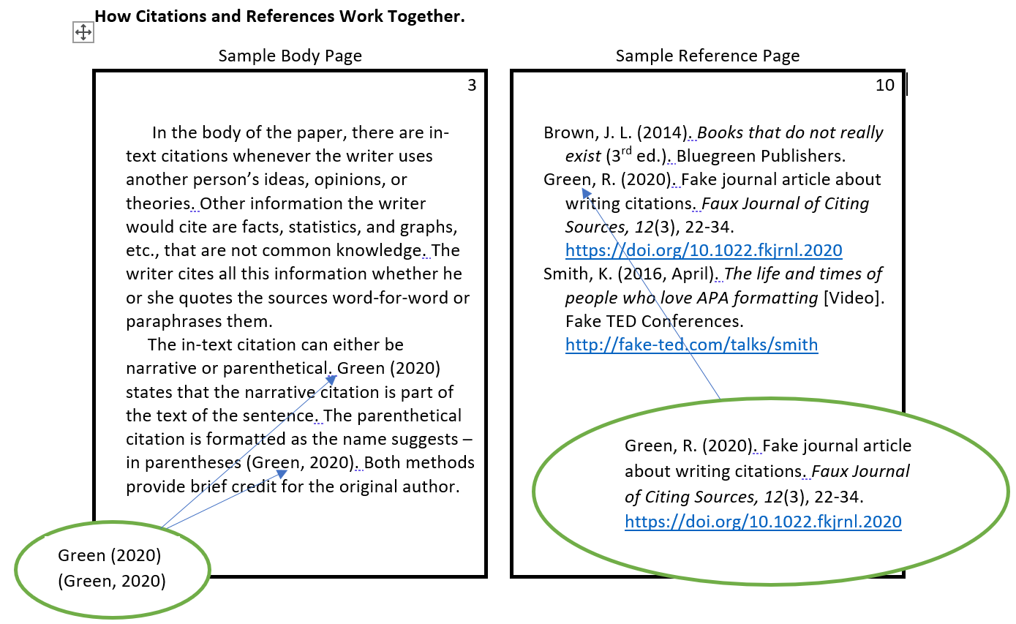
How citations and references work together

Slide 15
A Closer Look
In-text citations and references. There are several types, but they all have the same basic elements.
Many examples are available at https://apastyle.apa.org/style-grammar-guidelines/references/examples

Slide 16

All references answer four questions
When?
What?
Who?
Where?
Who?
When?
Citations answer the first two questions

Slide 17
All references answer four questions
Date
Title
Author
How to access
Author
Date
Citations answer the first two questions

Slide 18
Reference examples: e-book
When
What
Who
Jackson, L. M. (2019). The psychology of prejudice: From attitudes to social action (2nd ed.).
American Psychological Association. https://doi.org/10.1037/0000168-000
Where
Narrative citation: Jackson (2019) ; Parenthetical citation: (Jackson, 2019)

Slide 19
Reference examples: print book
When
What
Who
Sapolsky, R. M. (2017). Behave: The biology of humans at our best and worst. Penguin Books.
Where
Narrative citation: Sapolsky (2017) ; Parenthetical citation: (Sapolsky, 2017)

Slide 20
Reference examples: Journal Article with doi
When
What
Who
Grady, J. S., Her, M., Moreno, G., Perez, C., & Yelinek, J. (2019). Emotions in storybooks: A comparison of storybooks that
represent ethnic and racial groups in the United States. Psychology of Popular Media Culture, 8(3), 207–217.
https://doi.org/10.1037/ppm0000185
Where
Narrative citation: Grady et al. (2019) ; Parenthetical citation: (Grady et al., 2019)

Slide 21
Reference examples: Journal Article with direct hyperlink
When
What
Who
Stegmeir, M. (2016). Climate change: New discipline practices promote college access. The Journal of College
Admissions, 12(231), 44–47. https://www.nxtbook.com/ygsreprints/NACAC/nacac_jca_spring2016/#/46
Where
Narrative citation: Stegmeir (2016) ; Parenthetical citation: (Stegmeir, 2016)

Slide 22
Reference examples: YouTube video
When
Who
What
Harvard University. (2019, August 28). Soft robotic gripper for jellyfish [Video].
YouTube. https://www.youtube.com/watch?v=guRoWTYfxMs
Where
Narrative citation: Harvard University (2019) ; Parenthetical citation: (Harvard University, 2019)

Slide 23
Reference examples: Online news article
When
What
Who
Bologna, C. (2019, October 31). Why some people with anxiety love watching horror movies.
HuffPost. https://www.huffpost.com/entry/anxiety-love-watching-horror-movies_l_5d277587e4b02a5a5d57b59e
Where
Narrative citation: Bologna (2019) ; Parenthetical citation: (Bologna, 2019)

Slide 24
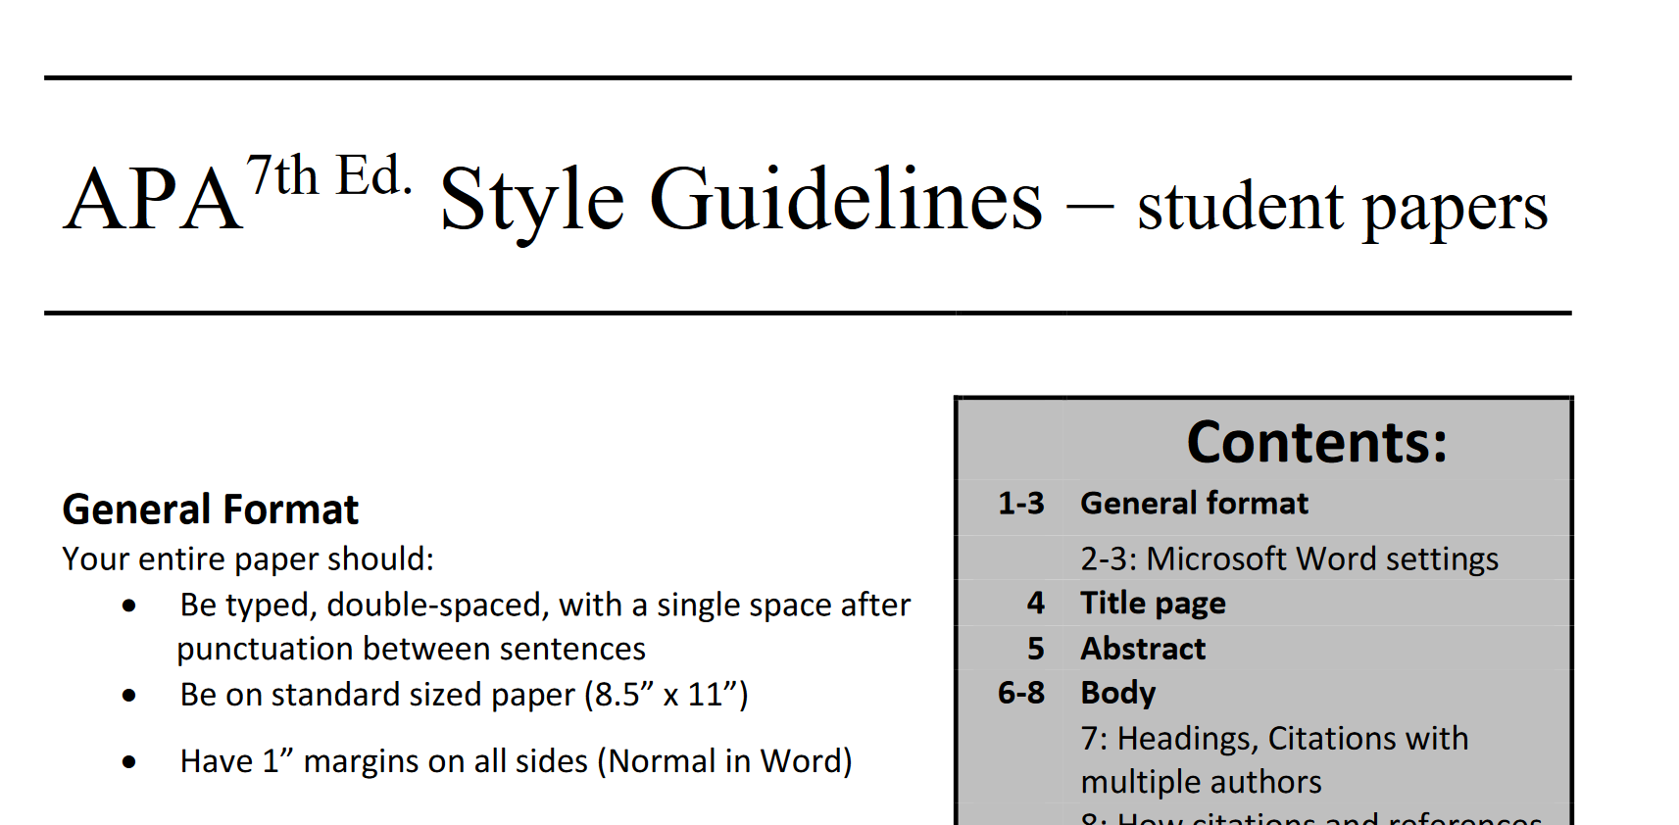
http://drrichardgreen.com/apawriting-helps.html

